Slide 1

Contact
Six minor defects
Clicking on the links opens an email from the user’s personal email address
Even when the user is not logged in
One major defect – conflicting contact details

Slide 2
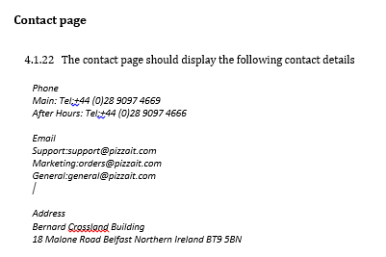
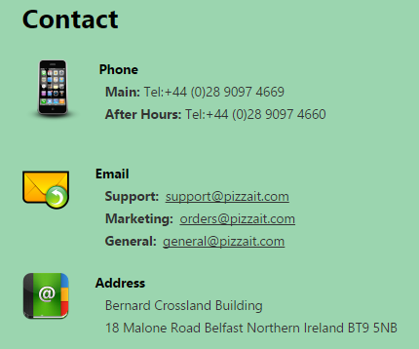
Contact

